Slide 1

PowerShell Core
Iain Brighton 22nd September 2017

Slide 2


Thank you to our sponsors

Slide 3
Iain Brighton
Principal Consultant @ Virtual Engine
Automation and end-user computing focused company
RES Certified Trainer (RCT) and Valued Professional (RSVP)
Amateur developer and PowerShell “junkie”
Community DSC resource contributor
Lability and PScribo author

Slide 4
Agenda
.NET What?
PowerShell Core
Windows PowerShell
Demo time!
Desired State Configuration
Wrap Up
Questions

Slide 5
.NET What?
.NET Framework
The "full" or "traditional" flavour of .NET that's distributed with Windows
.NET Core
Cross-platform .NET that can run on Windows, Mac, and Linux
Subset of the “full” .NET framework API surface
Portable installation
.NET Standard
Avoids recompiling for different targets, i.e. PCLs
Common API interface that is supported cross-platform

Slide 6
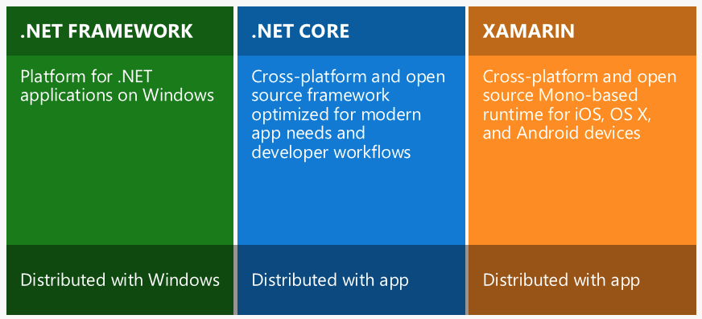
.NET Distribution

Slide 7
What is PowerShell Core?
Open-source, cross-platform PowerShell
For Windows, Mac and Linux
Written on top of .NET Core
Full PowerShell language and remoting support
Support for all cmdlet types C#, script and CIM
Support for classes
Is the future of PowerShell
Except for Workflows ☺

Slide 8
Why PowerShell Core?
Azure, Azure, Azure!
Manage Azure from Windows, Mac or Linux
Reduce adoption friction
Decouple from Windows Management Framework
And WMI
Provide cross-platform management tooling
VSCode

Slide 9
Windows PowerShell
Windows PowerShell 5.1 will continue to be distributed in-box
Tied to Windows Management Framework
Based upon the “full” .NET Framework
Active Windows PowerShell development is ceasing
High-priority fixes will still be made available
New features may be back-ported for compatibility
Windows PowerShell 5.1 may be the last ever release..

Slide 10
☺ Pray to the demo installation Gods

Slide 11
New Variables
$IsCoreCLR
$IsLinux
$IsMacOS ($IsOSX)
$IsWindows
$PSVersionTable.GitCommitId
$PSVersionTable.OS
$PSVersionTable.Platform

Slide 12
“Gotchas”
PowerShell.exe default is now -File
Linux aliases removed on Linux!
File encoding and line endings
No Windows-specific cmdlets
Get-Service
Get-LocalUser
No $PSVersionTable.BuildVersion/CLRVersion
Notes:
ls | gm is [System.String] not [System.IO.DirectoryInfo]
Lines endings: [System.Text.Encoding]::UTF8.GetBytes([System.Environment]::NewLine)

Slide 13
Windows Subsystem for Linux
Beta tag removed with the “Fall Creators Update” (1709)
Problems with Conhost.exe implementation in 1703
Universal installation script works
Manage WSL
Requires “Developer Mode” enabled
Requires Windows Subsystem for Linux feature installed
Get-WindowsOptionalFeature -Online -FeatureName Microsoft-Windows-Subsystem-Linux
lxrun.exe /install
lxrun.exe /uninstall

Slide 14
Windows PowerShell Remoting
WSMan
Industry-standard communication protocol
WinRM is Microsoft’s implementation of WSMan
SOAP/XML messaging/transport
Supports additional encryption with SSL/HTTPS
PowerShell Remoting Protocol (PSRP)
Runs on top of WinRM
Stateful protocol for instantiating remote PowerShell instances
Sending and receiving encrypted pipeline data
Linux requires OMI server and PSRP provider registration

Slide 15
PowerShell Core Remoting
New SSH transport option
PSRP over SSH
Removes the WinRM/OMI configuration
WinRM/OMI can still be implemented
Remote endpoint configuration and JEA not currently supported
Requires OpenSSH client installation on Windows
To permit remoting from Windows to Linux
Also requires SSH server configuration on Linux
Requires OpenSSH server installation on Windows
To permit remoting from Linux to Windows

Slide 16
☺ Pray to the PowerShell Remoting Gods

Slide 17
DSC Core
Soon-to-be-released version that aligns with PowerShell Core
No dependency on WMI or WMF
Xcopy-able package
Supports resources written in native C/C++ (no WMI), Python and PowerShell
Runs on Windows and Linux
Required (includes in package) PowerShell Core and .NET Core

Slide 18
Wrap Up
Target PowerShell Core for future development
Windows PowerShell is going away, albeit slowly
Consider cross-platform differences/quirks/caveats
Look at Win32 OpenSSH implementation
SSH key management will be important
Desired State Configuration Core
Changes coming to core resources
tug as an alternate Pull Server implementation
MacOS support

Slide 19
Resources
PowerShell 6.0 Roadmap
https://blogs.msdn.microsoft.com/powershell/2017/07/14/powershell-6-0-roadmap-coreclr-backwards-compatibility-and-more/
DSC Future Direction
https://blogs.msdn.microsoft.com/powershell/2017/09/12/dsc-future-direction-update/
PowerShell Remoting over SSH
https://github.com/PowerShell/PowerShell/tree/master/demos/SSHRemoting
Universal PowerShell Core Installer
https://cloudywindows.io/post/the-universal-powershell-core-installer-install-powershell.sh/

Slide 20
Resources
PowerShell remoting between Windows and Linux
https://4sysops.com/archives/powershell-remoting-between-windows-and-linux/
Tug - Open-source, cross-platform Pull/Reporting Server
https://github.com/PowerShellOrg/tug
Windows 10 Bash and PowerShell Redux
http://www.maxtblog.com/2017/01/windows-10-bash-and-powershell-redux/

Slide 21


Questions? https://github.com/iainbrighton/PSDAYUK-PowerShell-Core
@iainbrighton
iain.brighton@virtualengine.co.uk

Slide 22
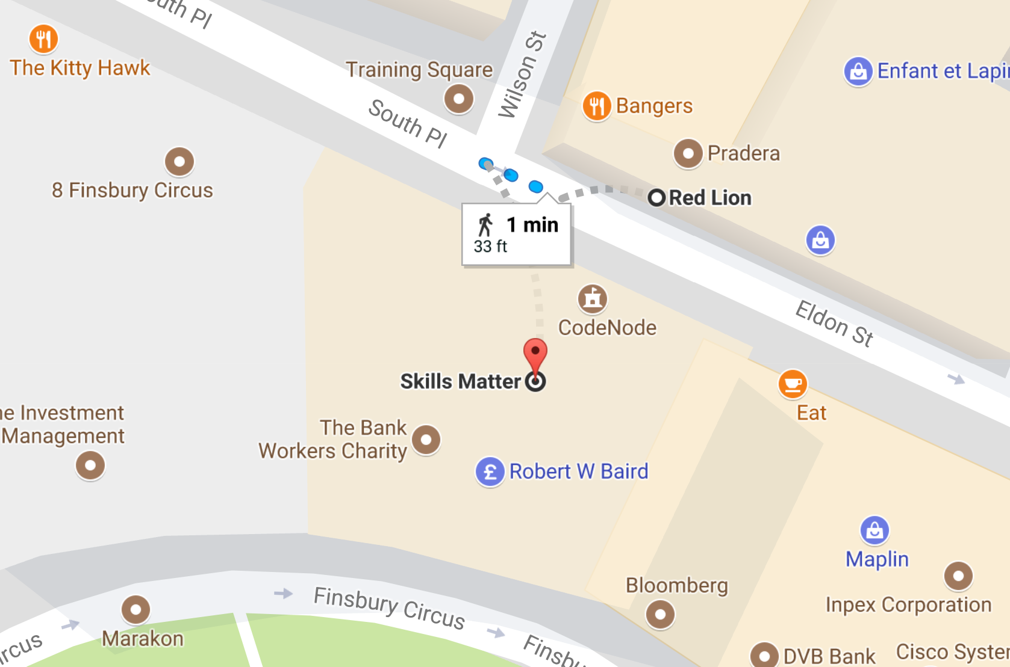
Thank You To Our Post-Event Drink Sponsors

